Slide 1
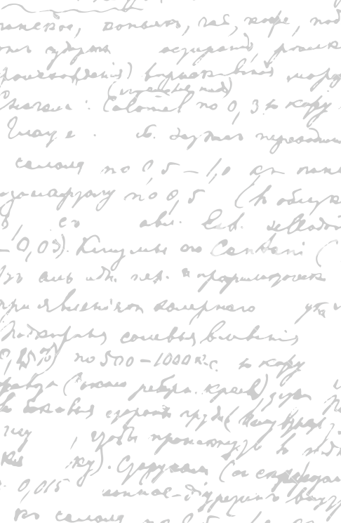



Andrew Wu 2133861w
Yes, Mate!
Project Supervisor Meeting 4
27 November 2020

Slide 2
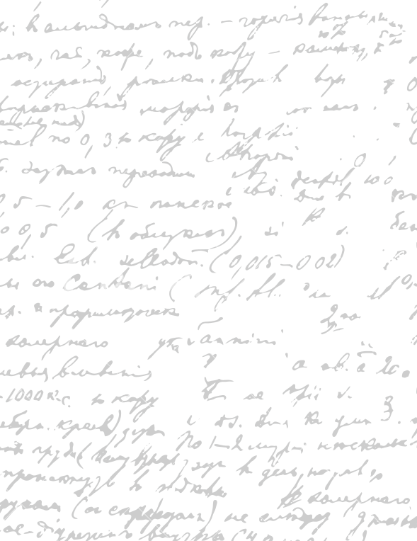



Start Recording

Slide 3
Main Topics
1. Evaluation for Digital Wireframe
2. Next Week

Slide 4

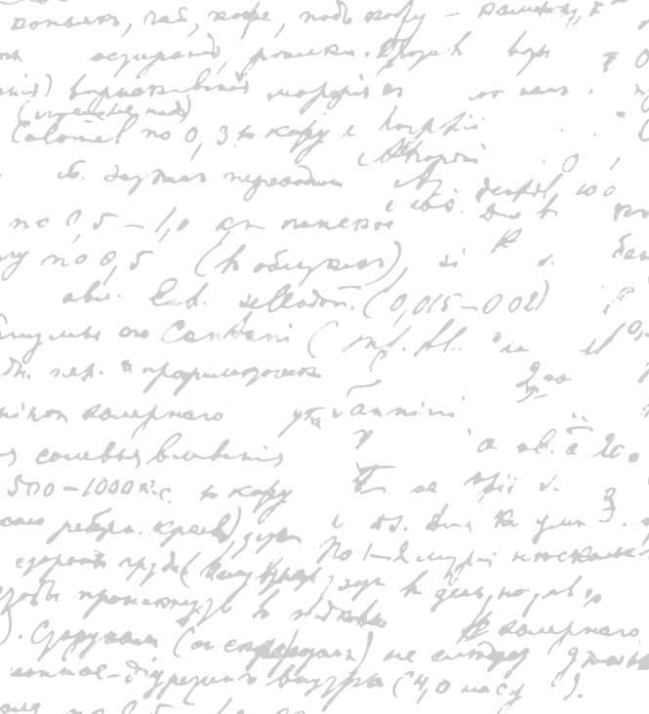

Show Digital Wireframe

Slide 5
Imagine 20 people ordering
Imagine worst case scenasios
Change the prototype to 20 people ordering
Notes for Digital
Wireframe

Slide 6
Continue to Write the Digital Wireframe
Evaluate the Digital Wireframe with Stephen and my Family
Next Week

Slide 7
Do you have some recommendation when looking for logo design?
Questions

Slide 8
End

